Slide 1

What I learned from monitoring more than 30 Machine Learning Use Cases
Pydata, 11.04.2022

Slide 2

HEY, I AM LINA WEICHBRODT
Lead Machine Learning Engineer at German Internet Bank DKB
Ex Senior Research Engineer at Zalando
>30 models: Recommender Systems, Personalization, NLP in Customer Service, Finance
Large scale production systems

Slide 3
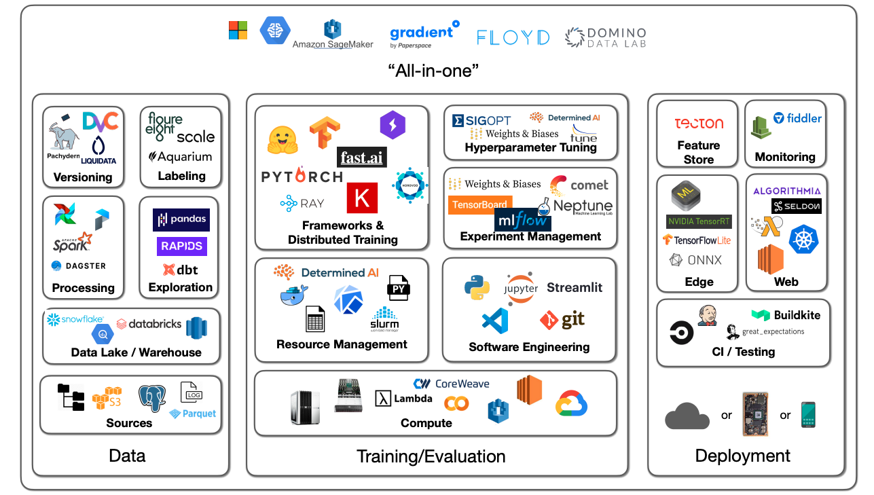
Machine Learning Tooling can be a little overwhelming
Notes:
Source: Full Stack Deep Learning - UC Berkeley Spring 2021, https://fullstackdeeplearning.com/spring2021/lecture-6/

Slide 4

Agenda
sdfdsf
Add ML Monitoring
Use simple tooling
Implement Basic Software Monitoring
Notes:
Notes:
This talk also applies to you if you don’t have anything as a service (pure batch usecase)

Slide 5
Agenda
sdfdsf
Add ML Monitoring
Use simple tooling
Implement Basic Software Monitoring
Notes:
Notes:
This talk also applies to you if you don’t have anything as a service (pure batch usecase)

Slide 6
Software Monitoring Basics
Everybody(!) experiences regular problems
Google Cloud Health
AWS Health
Typical: bugs, human error
You cannot avoid problems, just detect them fast and act based on severity
Notes:
Notes
You want to know:
If customers experience slow / bad responses
If you loose money, e.g. less orders or fail a guaranteed level of service or customer looses money
Problems come with different severities:
Level 1: Critical with high impact
Level 2: Major with significant
Level 3: Minor, low impact

Slide 7
Use the four golden signals
Latency: the time it takes to serve a request
Traffic: the total number of requests
Errors: the number of requests that fail
Saturation: the load on your network and servers
we focus on symptoms, meaning end-user pain, not causes
Use them for all of your products
Notes:
Notes:
These are the basics that you need for all products. Source: Google Site Reliability Book https://sre.google/sre-book/monitoring-distributed-systems/
Errors: typically because 400er Error (wrong inputs) or 500er (exception on your end)
Adaption to batch prediction:
Latency: Check if the overall time (e.g. when you have a nightly run) is fast enough
Traffic: identical, monitor the amount of examples, e.g. per hour/day
Errors: Find out how you can collect errors during batch prediction: some frameworks throw exceptions when one example in a batch has a problem, others only log a warning you miss when you automate
Source ”focus on end user pain”: https://prometheus.io/docs/practices/alerting/

Slide 8
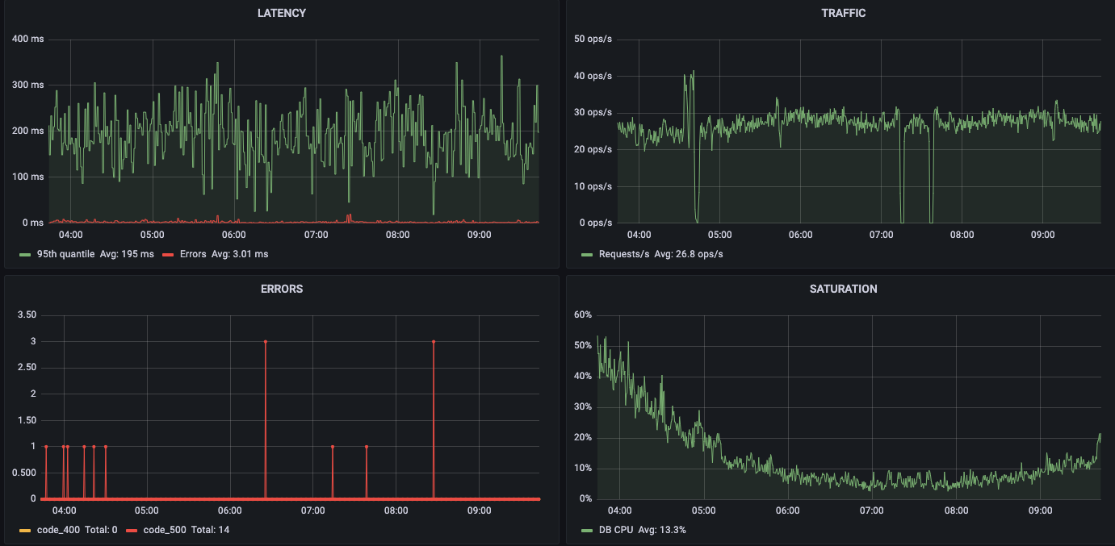
Monitoring in practice: Live Dashboards
Show dashboard
Review during indicdent
Review weekly for operational review
Show alerts
If alert, pager or fix during business hours
Notes:
Notes:
Play with this dashboard at https://play.grafana.org/d/000000109/the-four-golden-signals. The latency shows the median. It is a best practice to add the 95th quantile and the 99th quantile
This is a Grafana Dashboard. Your company might have another vendor. The vendor is less important than to have a good dashboard!
Dashboards are useful:
Review your performance over time
Check possible issues during an incident
Review weekly for operational performance insights

Slide 9
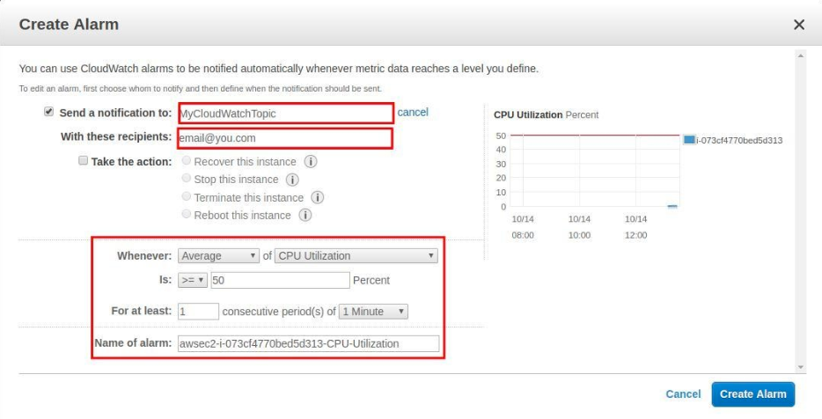
Monitoring in practice: Get notified if a metric is too low or high
Example with AWS Cloudwatch (many vendors offer this needed functionality)
Notes:
Notes
The alert shows up on a monitor, email etc.
Important alerts go to 24/7 oncall engineers who fix immediately. Other alerts wait until you are in the office again

Slide 10
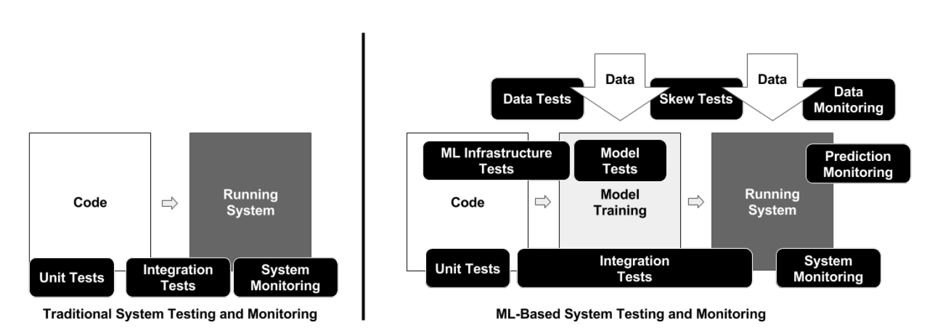
Is traditional software monitoring enough?
Google paper „ML Test Score“ shows the higher complexity
Picture: Complexity of ML, compare to Software Products
As a result, I recommend ML only for high value use cases or central processes
Exception: you are building trust in ML in your organization, so you start with a small project
Notes:
https://research.google/pubs/pub45742/

Slide 11
Silent failures causes huge commercial impact
Examples of silent failure I personally experienced:
Input data changes
Client calling us e.g. unit change in fraud model from sec to msec
External service we call e.g. article service migration with data loss
Aggressive post-processing filters applied
Optional field was filled 80%, drifted to 20%
Filter “on sale” articles -> fewer articles during non-sale season
Bugs in our own code e.g. get last 10 orders vs last 10 bought articles
Model is automatically trained and released, but model is worse
Tensorflow version not pinned, we got a faulty version
Client changes the way the product works without telling us, e.g. product is now used by not logged in users
None of these things create an error, slowness, saturation. SILENT!
Bigger $$$ impact than most model improvements
Notes:
TODO:
- Clean up list
- stamp “risk of permanent, silent loss”

Slide 12
Agenda
sdfdsf
Add ML Monitoring
Implementation and Tooling
Implement Basic Software Monitoring

Slide 13
Practical Example: Process Cost Optimization for Private Loans
More than 90% of requests for private loans come from platforms like Check24, Smava
Platforms call many banks which call the „Schufa“ (German credit score agency) → low take-up rate
High monthly cost for credit reports
Can we predict with high certainty which applications are ultimately rejected and reject before calling the Schufa?

Slide 14
Practical Example: Process Cost Optimization for Private Loans
Predict: Loan request rejected/accepted
Data:
Application data from the last n months
Unknown: credit agency response (existing loans at other banks, credit score, special events like account cancelations)
Input fields:
Application information, e.g. income, rent, family status, employment
Process data e.g. current risk configuration, age limits, other configuration
Past applications by same person
Other fields: is_customer, platform, type of loan,…

Slide 15
Symptom based monitoring: prioritize backwards from output
Priority 1
Evaluation metrics in production,
Stakeholder Concerns
Service Response (after postprocessing)
Model Prediction, Quality Heuristics
Calculated Features
Input data
Image source: Flaticon
Notes:
Notes:
If you monitor the output, your detect changes to the user experience.
If you monitor input data, it will help you to understand why the output changed and also helps you to detect smaller problems that are not visible in the output -> for later maturity stages, also has more false positives
you could monitor the user reaction e.g. click rate (not in picture). this is useful for true end-to-end-monitoring, but is technically harder to achieve (not real time, getting the data difficult) and only shows huge problems (output monitoring is less sparse than user reactions and less noisy). I recommend it only as an extra

Slide 16

Monitoring Priority 1: Evaluation Metrics in Production
Data Scientist:
“Can I monitor my evaluation metrics in production?”

Slide 17
Monitoring Priority 1: Evaluation Metrics in Production
Answer: Maybe!
Do you know the correct target close in time? Common problems:
Unknown result e.g. if an application is rejected because of a high fraud probability, we don‘t know if we made an error
Delayed result, e.g. if we predict the delivery time for a package we know the true delivery time days later
Filter bubble effect, e.g. algorithm decides what to show the customer. Unseen options cannot be evaluated

Slide 18
Monitoring Priority 1: Evaluation Metrics in Production
If you can, monitor the evaluation metrics in production
Store prediction and target
Calculate the metrics used during evaluation, e.g. batch job and or create an endpoint to receive a feedback call
Add metrics to dashboard and create an alert
Loan Rejection Prediction:
If we reject, the correct target is unknown.
We create “production evaluation data” where the model is called but not used for decision making
For this data we know the prediction and the correct, actual result
Calculate the metrics and compare them to the expected performance
Notes:
If you can get the target, but they are delayed, I still recommend to monitor the evaluation metrics in production. You should however add response distribution monitoring to get real-time-monitoring

Slide 19
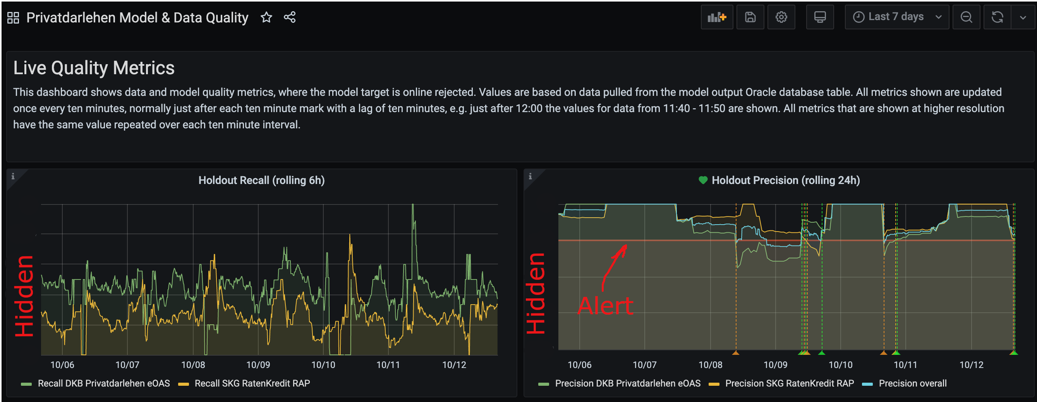
Real-Time Dashboard: Evaluation Metrics in Production

Slide 20
Monitoring Priority 1: Stakeholder Fear Signals
Monitor what the stakeholders want to avoid
Machine Learning Applications need trust → ask stakeholders for their worst-case scenarios, e.g. service makes wrong decision, is uncertain, doesn’t answer
Put these fears into metrics to make sure you would detect these scenarios
Add metrics to dashboard and alert
Loan Rejection Prediction:
Fear: unfairly reject applications → alert on precision <95%
Fear: Make application slow → alert on p95 speed <300 msec

Slide 21
Symptom based monitoring: prioritize backwards from output
Priority 2
Evaluation metrics in production,
Stakeholder Concerns
Service Response (after postprocessing)
Model Predictions, Quality Heuristics
Calculated Features
Input data
Image source: Flaticon

Slide 22
Insight: A lot of Machine Learning Monitoring is done without the evaluation metrics
Metrics to evaluate Machine Learning Models
Metrics for monitoring Machine Learning Models
Measured to evaluate model quality, e.g. precision, recall, NDCG, …
To calculate evaluation metrics we compare the prediction against outcome in production
Often not available or not available close in time
Measured in order detect a problem, not to capture model quality
Detection Metrics are easier to implement

Slide 23
Monitoring Priority 2: Response distribution
Monitor the response distribution
monitoring the output is a good „catch all“ technique, needed if you cannot calculate evaluation metrics in production or if there is a delay between prediction and outcome
Detect slow or sudden shifts of response distribution
Often easy to do (just one or few outputs)
The importance of a change is more clear compared to input monitoring (an input field‘s change might be not relevant to the output)
Rule Based Distance Metrics: Median, Quantiles, Share of empty/insufficient outputs
Statistical distance metrics: Kolmogorov-Smirnov Statistic, D1 Distance, Population Stability Index
Notes:
Kolmogorov-Smirnov Statistic : Max Distance between Cumulativ

Slide 24
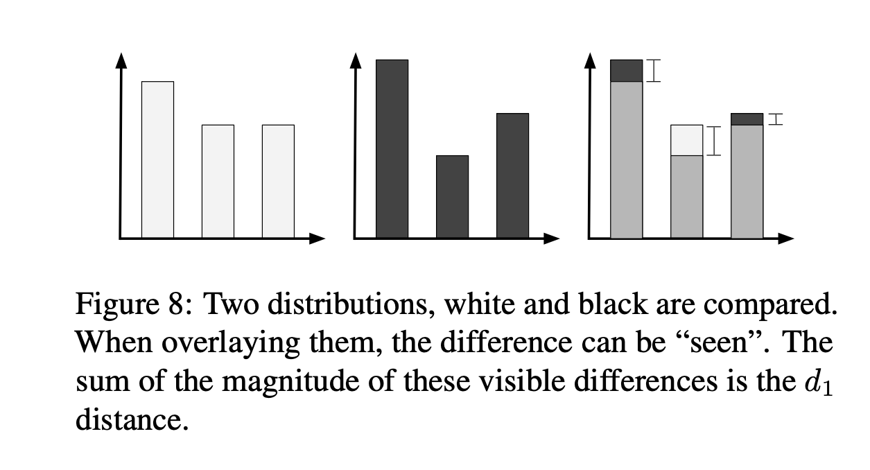
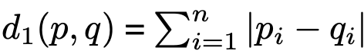
Monitoring Priority 2: Response distribution
Example distribution distance metric: D1
→ Sum of Distances of Probability Density Functions
Source: Google Paper: Data Validation for Machine Learning 2019

Slide 25
Monitoring Priority 2: Heuristic Quality Metrics
Heuristic Quality Metrics
Create use-case-specific, human understandable quality indicators, e.g. heuristic for a „really good“ or „bad“ response and common sense heuristics
The metric doesn’t have to be a great quality indicator, just go down if quality goes down (do not aim to measure objective quality!)
E.g.
Common-Sense-Metric for a personalized algorithm: Share of personalized responses
Bad responses metric: Share of empty responses/fallback responses
Common-Sense-Metric for a personalized home page ranking: What is the rank of a user‘s most used carousel?

Slide 26
Symptom based monitoring: prioritize backwards from output
Priority 3
Evaluation metrics in production,
Stakeholder Concerns
Service Response (after postprocessing)
Model Output, Quality Heuristics
Calculated Features
Input data
Image source: Flaticon

Slide 27
Monitoring Priority 3: Input and Feature Data distribution
Monitoring Input and feature distribution
Compare difference between training and serving or train on features you logged (Google Rules of Machine Learning, Rule #29)
Compare the serving distribution over time: a sudden shift indicates a problem
→ Rule Based Distance Metrics: Median, Quantiles, Share of empty/insufficient inputs
→ Statistical distance metrics: Kolmogorov-Smirnov Statistic, D1 Distance, Population Stability Index
Notes:
Exception, priority 1: do the comparison between training and serving or train at least manually during launch (often there are differences)

Slide 28
Agenda
sdfdsf
Add ML Monitoring
Implementation and Tooling
Implement Basic Software Monitoring

Slide 29




Survey: Do I need an ML Ops Monitoring Tool?
ML Ops Monitoring Tools:
Focus on monitoring and/or explainability, e.g. aporia, superwise
Monitoring as part of full featured tool, e.g. Seldon, Sagemaker
Survey under practitioners in the ML Ops Community Slack: “How are your production experiences using dedicated machine learning monitoring tools?”
→ many companies with models in production do not have a custom framework in use

Slide 30


Start simple, re-evaluate later
Pure Data Science Product, starting from scratch or very advanced product
evaluate full featured machine learning platforms
Your company offers services for monitoring and alerting, only some of your services are machine learning services
→ use existing tools for metric collection and alerting, e.g. Prometheus, Grafana, a job scheduler

Slide 31
Monitoring: The stack
Advantages of using existing monitoring and alerting stack:
No new tool(s) needed
Immediate start
Usually sufficient (unless you do a lot of ML debugging)
Integration with other metrics on same dashboard
Machine Learning Tools develop fast at the moment → many are not mature yet

Slide 32
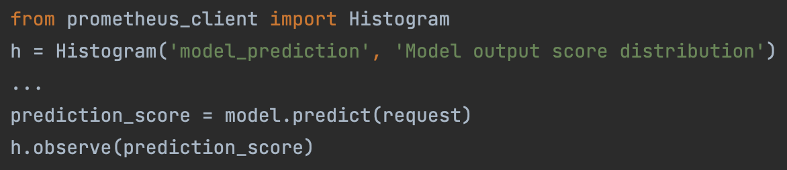
Monitoring: Example Implementation
Add metrics to your inference code:
For complicated calculations: log response to storage e.g. s3, run a script every 10 mins to calculate (raw) metric components
Create a dashboard and create alerts

Slide 33
Takeaways
Monitor golden signals + add machine learning monitoring
Prioritize monitoring output metrics (user impact!) like response monitoring and if available evaluation metrics in production
You often don’t need a new tool, use the tools you already have and add a few metrics
Notes:
Notes:
If you have time to implement more monitoring, monitor the input and feature distributions

Slide 34

Talk to me
We are looking for a Machine Learning Lead Engineer,
feel free to ask my any questions here or in slack.
Join the ML Ops Slack Channel to talk to others working on Machine Learning in production.

Slide 35
BACKUP

